Slide 1
Suitable Colleges for Hawaiian Students in California
Kamalu Makekau-Whittaker & Nathan Wright

Slide 2
Background
think about going elsewhere (out of Hawaii) for college
choose schools without visiting, or knowing anything
return home from college before graduating, because of homesickness
do not consider looking at the environment
The overall goal of this study is aimed to help future college students find the best school(s) in California, that is most like home, which will hopefully then eliminate a lot of the homesickness or depression seen in those students.

Slide 3
Research Question
Which colleges will be most suitable (most like home) for Hawaiian kids to attend for college?

Slide 4
Data Types
Vector:
College campuses
California Census Tract
Local Hawaiian food vendor
Businesses
Seashore
Raster:
Elevation
Temperature
Vegetation

Slide 5
Criteria
Distance from the ocean (10 miles = 16093 meters)
Pop of Native Hawaiian/Pacific Islander in the area ( Higher than 300)
Number of Popular Hawaiian food businesses in area (3)
Elevation (Lower elevation: 457 meters, 1500 ft )
Average temperature 50
Vegetation in area (closer the better)

Slide 6
sources
Vegetation = Cal fire department https://frap.fire.ca.gov/data/frapgisdata-sw-fveg_download
Temperature = USGS
Shoreline = NOAA (USGS) https://pubs.usgs.gov/of/2006/1251/#gis
ELEVATION SANTA BARBARA and San Diego, same source =
https://www.sciencebase.gov/catalog/item/5c1af7bbe4b0708288c5e914
TEMPERATURE for U.S. =
https://www.sciencebase.gov/catalog/item/57a26dd6e4b006cb45553f7a

Slide 7
Analysis Steps
Vector:
Create a buffer of 10 miles around seashore
Select by attribute where you get the counties with Hawaiian population is greater than 300
Export selected data
Intersect the layers
Raster:
Reclass Elevation where anything below 1500 ft is 1 and the rest is 0
Reclass temperature hottest = 4 and coldest = 1
Reclass Vegetation (41-43 = 1 and everything else is 0)
Euclidean distance from the schools
Raster Calculator to overlay all layers

Slide 8
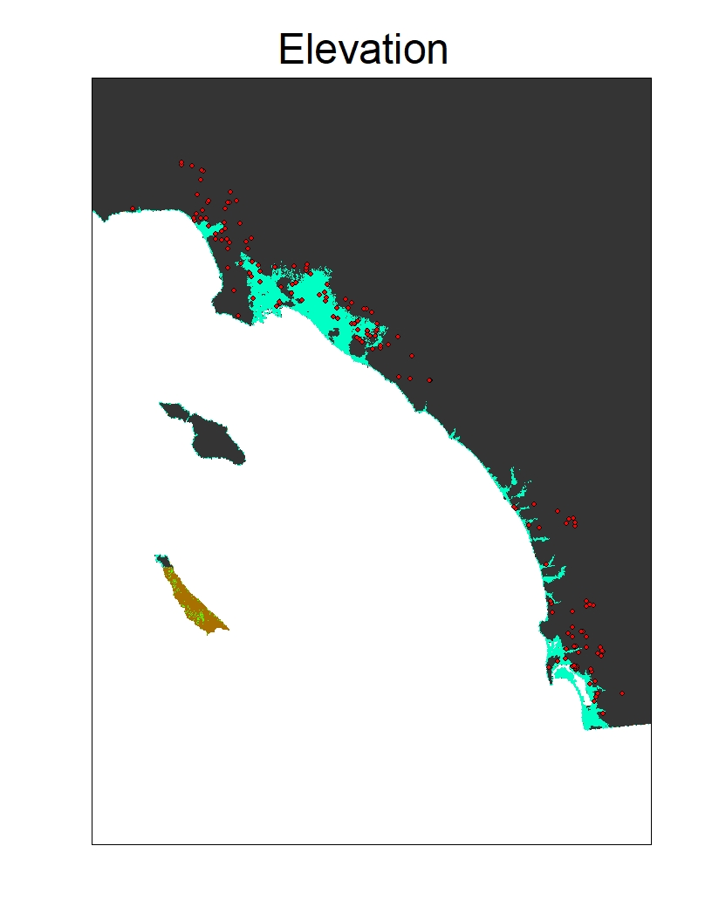

Slide 9
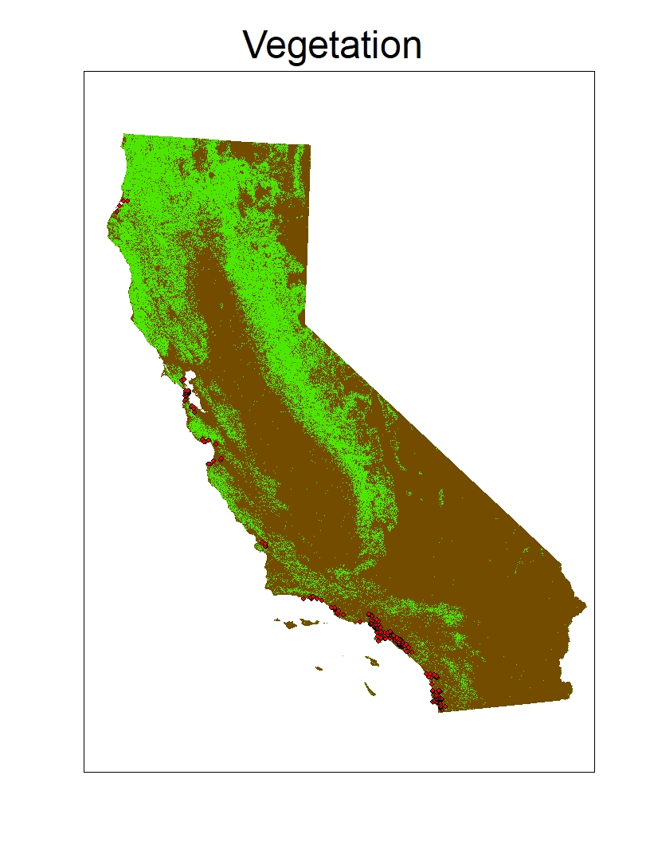

Slide 10
